Slide 1
learn how to program in Scratch

Slide 2
learn how to program in C

Slide 3
learn how to solve problems

Slide 4
learn how to solve problems with functions

Slide 5
learn how to solve problems with variables

Slide 6
learn how to solve problems with conditionals

Slide 7
learn how to solve problems with loops

Slide 8
learn how (not) to solve problems

Slide 9
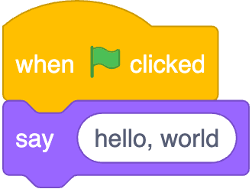

Slide 10
#include <stdio.h>
int main(void) {
printf("hello, world\n");
}

Slide 11
#include <stdio.h>
int main(void) {
printf("hello, world\n");
}

Slide 12
source code

Slide 13
01111111 01000101 01001100 01000110 00000010 00000001 00000001 00000000 00000000 00000000 00000000 00000000 00000000 00000000 00000000 00000000 00000010 00000000 00111110 00000000 00000001 00000000 00000000 00000000 10110000 00000101 01000000 00000000 00000000 00000000 00000000 00000000 01000000 00000000 00000000 00000000 00000000 00000000 00000000 00000000 11010000 00010011 00000000 00000000 00000000 00000000 00000000 00000000 00000000 00000000 00000000 00000000 01000000 00000000 00111000 00000000 00001001 00000000 01000000 00000000 00100100 00000000 00100001 00000000 00000110 00000000 00000000 00000000 00000101 00000000 00000000 00000000 01000000 00000000 00000000 00000000 00000000 00000000 00000000 00000000 01000000 00000000 01000000 00000000 00000000 00000000 00000000 00000000 01000000 00000000 01000000 00000000 00000000 00000000 00000000 00000000 11111000 00000001 00000000 00000000 00000000 00000000 00000000 00000000 11111000 00000001 00000000 00000000 00000000 00000000 00000000 00000000 00001000 00000000 00000000 00000000 00000000 00000000 00000000 00000000 00000011 00000000 00000000 00000000 00000100 00000000 00000000 00000000 00111000 00000010 00000000 00000000 00000000 00000000 00000000 00000000 ...

Slide 14
machine code

Slide 15
input →
→ output

Slide 17
source code →

Slide 18
source code →
→ machine code

Slide 19
compiler
source code →
→ machine code

